Slide 1
DEEP FAKE DETECTION
The Eye of Authenticity

Slide 2

Team Virtual Visionaries
Mentor: Mr. Rajesh Bolla
Sri Harshitha (TL) - AI/ML Engineer
Prakeerthi - AI/ML Engineer
Srihitha - AI/ML Engineer
Naga Lakshmi - AI/ML Engineer
Raja - Cloud Engineer
Eswari - Cloud Engineer

Slide 3
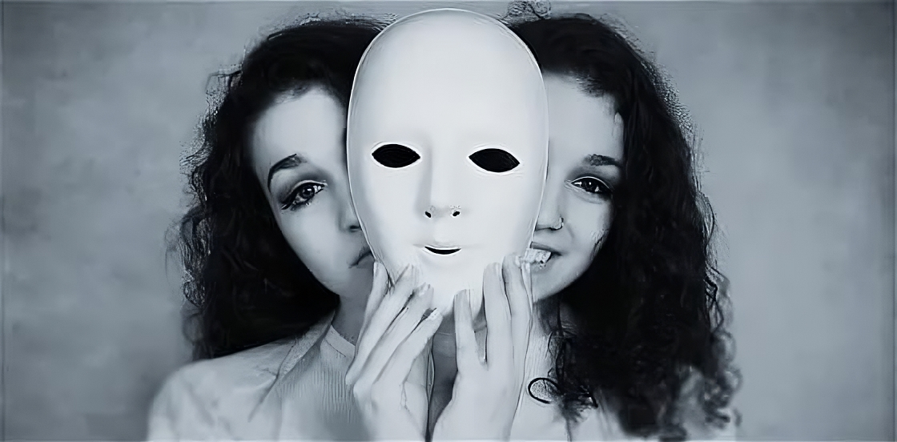
INTRODUCTION
DeepFake Detection is the task of detecting fake videos or images that have been generated using deep learning techniques.
DeepFakes are created by using Deep learning algorithms to manipulate or replace parts of an original video or image, such as the face of a person.
The goal of deepfake detection is to identify such manipulations and distinguish them from real videos or images.

Slide 4
Reasons for pursuing this project !
We chose this project to address the challenge of detecting the truth behind IMAGES/VIDEOS.
We couldn't find any websites that detect whether an IMAGE/VIDEO is REAL or FAKE, so we decided to create one ourselves.
Through our website, we will detect whether the uploaded data is real or fake. This will enable people to discern the truth about the data they encounter.

Slide 5
Data Insights
The dataset, obtained from the Kaggle website, occupies 10.16 GB of storage space.
It comprises three folders categorized as:
Celeb – YouTube – real : 712 videos
Celeb – YouTube – fake : 5305 videos
Test : 518 videos
For convenience, we have downsized the dataset to 358 MB in size.
This reduced dataset now consists of 250 videos.
Celeb – YouTube – real : 100 videos
Celeb – YouTube – fake : 100 videos
Test : 50 videos

Slide 6
Architecture
We have developed a system to demonstrate the analysis and differentiation of authentic and manipulated media.
The process involves the following steps:
Data Collection: Initially, we gather a comprehensive dataset containing both authentic and synthetic (deep fake) media.
Preprocessing: These includes segmentation, resizing, and augmentation, are applied to optimize the data for training purposes.
Feature Extraction: This process utilizes techniques like CNN to identify distinctive patterns and traits specific to manipulated content.

Slide 7
Model Training: Once the features are extracted, a Deep learning model is trained to classify input media as either real or fake by using InceptionResNetV2(pre-trained) model.
Evaluation and Validation: Assessment is based on the probability of frames extracted from a video. Our model undergoes validation using the "Test" folder.
User Interface: For simplicity, we have developed a website as the interface for users to upload their data.
Deployment: The website has been made public by hosting it on the AWS cloud. Users can access it using our IP address.

Slide 8
Library Suites:
Pre-Trained Model:
Libraries:
InceptionResNetV2
NumPy
Pandas
Sklearn
Tensorflow
Keras
OpenCV
DLIB

Slide 9
Advantages:
Maintaining trust in media and society
Ensuring the safety of women
Optimizing the time to uncover the truth
Safeguarding personal privacy
Combatting Misinformation

Slide 10
Conclusion:
Deepfake detection is a critical area of research and development that plays a crucial role
Helps to combat against the spread of misinformation, protecting individuals' privacy, and preserving trust in media and society.

Slide 11
Thank You

